Slide 1




Summer Break Homework
(2020-21)
Class – V

Slide 2

English
Choose one paragraph on any topic of your choice and write it in cursive handwriting neatly. One page daily in your previous class English subject notebook. (Mention the date on top).
View all videos and listen to all audios related to English subject (from your online classes) and complete all the work in your fair notebook if you have missed anything. In case the work is completed. Revise work thoroughly.
Read chapters we have already done and learn question answers and word meanings.
Referring Page number 10 (literature book)Write a paragraph in your note book in about 50-60 words imaging you are Sancho and describe What do you think about Don - Quixote.
Learn to see a dictionary.
Do page 19-24 in your Grammar book(with a pencil).

Slide 3
Hindi
7 अप्रैल से ग्रीष्मावकाश समाप्त होने तक प्रत्येक सप्ताह की कोई एक अपनी मनपसंद व उपयोगी समाचार को अखबार की भांति लिखिए और साथ ही उसी अखबार की कटिंग भी चिपकाए।
अपने आसपास घटित किसी भी घटना के आधार पर अखबार में छपवाने हेतु एक समाचार स्वयं लिखिए।
एक प्रेरणादायक कहानी पढ़कर निम्न प्रश्नों के उत्तर लिखिए।
  कहानी का नाम
  लेखक का नाम
  जिस पुस्तक से पढ़ी है,उस पुस्तक का नाम
  पुस्तक के पब्लिशर का नाम
  किताब का मूल्य
  कहानी के मुख्य पात्रों के नाम
  अपना पसंदीदा संवाद( अगर कहानी में हो)
  कहानी की शिक्षा।
NOTE: उपरोक्त दिया हुआ कार्य पिछले वर्ष की हिंदी कॉपी में कर सकते हैं।

Slide 4
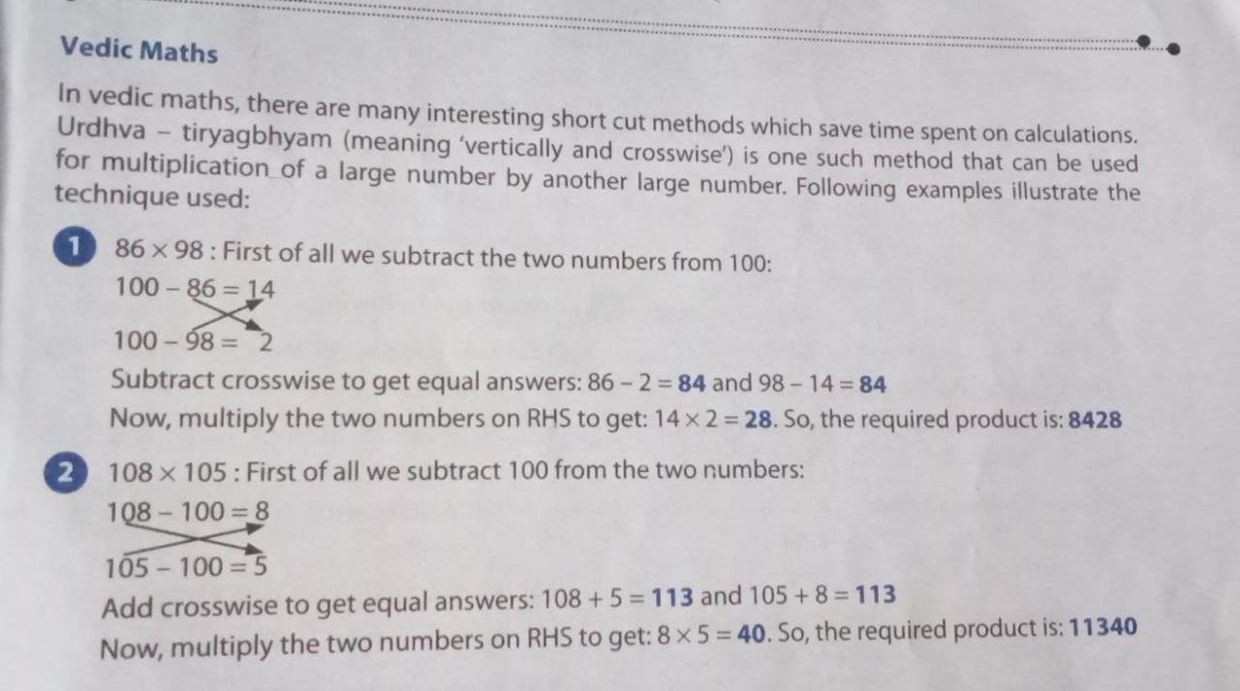
Mathematics
Learn table from 2 to 20.
Take help from this picture(↑) and try to solve any 5 questions yourself.
Learn about different type of angles. You can take help from your book's chapter 12 and then do the worksheet given at page number 174 of your book.
You have to do these questions of your homework in a very thin notebook.

Slide 5
Science
NOTE: View all your videos and pdf’s given to you and clear your concepts. Do complete your written work in notebook.
NOTE: Both the homework's are compulsory.
Perform the following experiment with the help of the given steps:
    Step 1: Take some kidney beans (rajma) seeds, cotton wool, four transparent bowls and some water.
    Step 2: Put some cotton and kidney beans in each bowl.
    Step 3: Pour some water in the first bowl and keep it in the sunlight. Keep the second bowl with some water in a dark room, the third one without water in the sunlight and the fourth one without water in a dark room or a cupboard.
  Observe the bowls for 2-3 days.
  Click and paste or draw the pictures of the four bowls and write your observations of all the four bowls.
Write a small essay on environmental changes you experienced during lockdown in your notebook.

Slide 6
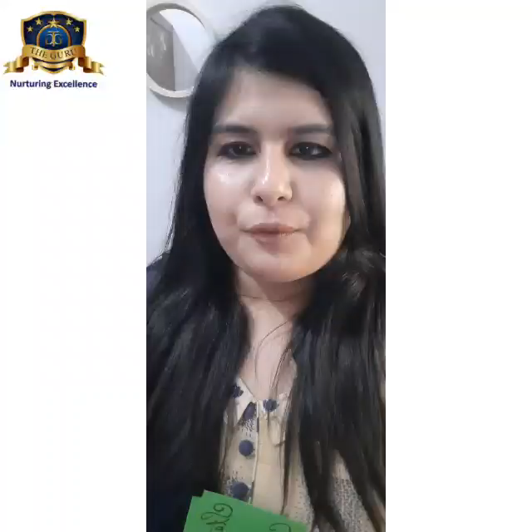
Social Studies
Make a wall hanging of flashcards. In each card mention the states of India with its capital. Also mention the names of the continents and oceans of the world.

Slide 7
Computer
Read chapters(1 and 2) that we have already done and learn exercises and question answers.
Referring Page number 23 (computer book). Identify the Software (write the names of software with a pencil) and have fun.
Prepare a chart displaying "Generations of Computers" and Technology used in those computers. Mention 2 features of each Generation of Computers and show your creativity.
  (Hint: You can use drawing sheet or colored sheet from your old scrap book or any chart paper available at home).
NOTE: If you have any difficulty to find out the Generations of Computers, just open your book and refer page no. 8 to 10 and 14 also.

Slide 8
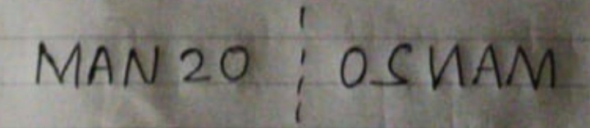
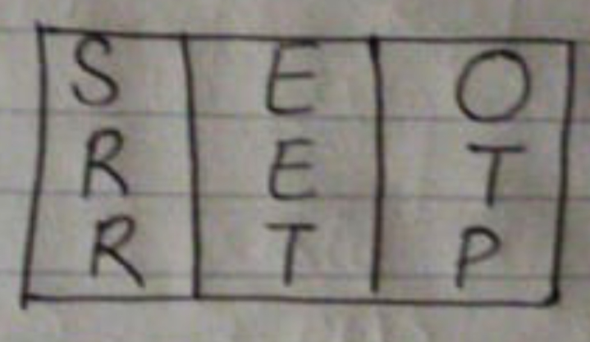
G.K.
Write 5 current affairs related to the each topic:
  Corona Virus [COVID - 19].
  Famous people of India like celebrity, politician etc.
Write some lines about the famous statue of India : “Statue of Unity”.
Reasoning
Write any 5 words with their mirror image views. For example:
In this puzzle you have to see how many three letters, four letters words or more letters words you can make from the nine letters shown in the figure. No proper names or no plurals are used.

